Slide 1
ARM CCS Project Basics
Vincent Han
Mar, 2014

Slide 2
Agenda
Environment and Compiler
Basic Components
Basic Operations

Slide 3
Environment & Compiler
For ARM project, we use Linaro GCC cross compiler just like C6000 compiler on TI DSP.
Linaro GCC cross compiler:
  Released by the Linaro organization
  Bases on GNU GCC baseline and has both versions to support bare-metal (Launchpad) and Linux ABI (Linaro) compilations
  Fully free and open source under the GPL license
  Better support Cortex-A15 pipeline and optimizations since GCC 4.7
  TI and ARM are major members, recommend to use Linaro compiler
Notes:
3

Slide 4
Build & Compile Procedures
We can see the main procedure for ARM is the same with DSP, but the intermediate files and needed source files are different.
Notes:
4

Slide 5
Agenda
Environment and Compiler
Basic Component
Basic Operations

Slide 6

Components For ARM CCS Project
In a typical ARM CCS project, 3 main component should be included in the project folder:
  Main C file, .lds file, and startup assembly.
  We should clear of the usage and functions of the C source file and .lds file, let’s talk about the startup assembly file.
Notes:
6

Slide 7
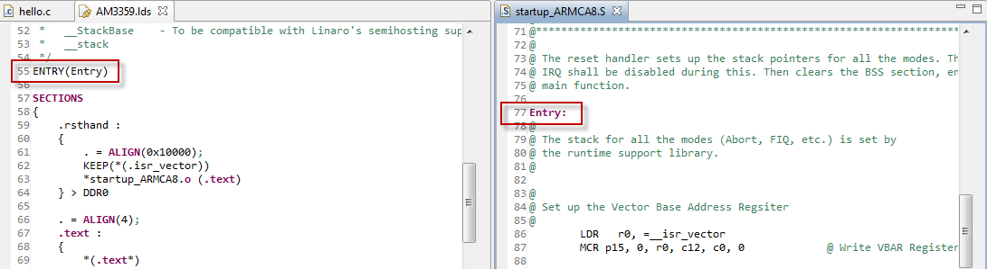
Components For ARM CCS Project
In DSP executable, there are lots of extra operations need to process such as initial stack, clear .bss, bringup C environment before execute the main function (by _c_int00)
ARM also need such kinds of operations before “main”.
The .lds file defined the “ENTRY” as the function named “Entry” in startup assembly file
Notes:
7

Slide 8
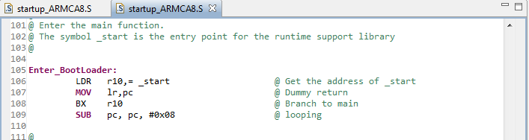
Components For ARM CCS Project
The startup assembly mainly initializes the vector table, then branches to the function named “_start”:
This function is in the library which will empty the .bss section, bringup the C environment then jump to the main function.
Notes:
8

Slide 9
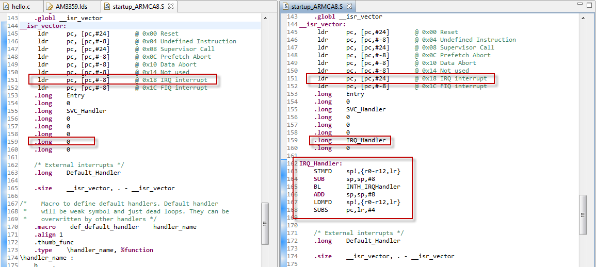
Components For ARM CCS Project
By changing the startup assembly file, we can add more operations (e.g. configure the interrupt vector table) at the early stage :
Notes:
9

Slide 10
Agenda
Environment and Compiler
Basic Component
Basic Operations

Slide 11
ARM CCS Project Basic Operations
Please refer the operation lab document
Notes:
11

Slide 12
Thank You!

